Slide 1


Masahiro Kamei, M.Eng.
<Date>

Slide 2

Outline
Executive Summary
Introduction
Methodology
Results
Conclusion
Appendix

Slide 3
Executive Summary
Summary of methodologies
Summary of all results

Slide 4
Introduction
SpaceY believes that reusable rocket boosters are the pivotal breakthrough needed to substantially reduce the costs incurred per launch. The majority of each launch cost is incurred by the booster stages, which have historically been consumed (burned up on re-entry) after a single use.
Other travel modalities within our experience lack such expendable hardware. Aircraft, ships, and trains are each completely re-usable following any given mission. We aim to make this true for space travel as well. While most rockets are designed to burn up on reentry, SpaceY rockets will not only withstand reentry but will also be able to land and be re-used for future missions.
Our objective is to estimate the probability of success among our competitor’s booster recoveries to inform the operating cost estimates for our own recoverable booster systems.

Slide 5

Section 1

Slide 6
Methodology
Executive Summary
Data collection methodology:
Extraction from the SpaceX REST API
Web scraping from the SpaceX Wikipedia entry.
Perform data wrangling
Following collection from JSON and HTML tables, the data was converted into a dataframe.
Perform exploratory data analysis (EDA)
EDA was supported through visualization techniques and SQL manipulations
Perform interactive visual analytics using Folium and Plotly Dash
We developed maps to geo-spatially visualize launch and recovery data.
We also developed dashboards to interactively assess differences between launch sites, payloads, and booster types.
Perform predictive analysis using classification models
Data was divided into training and testing data sets.
Training and test data were subjected to four different machine learning methods.
The method having the best test accuracy was selected.

Slide 7
Data Collection
Data was collected from the SpaceX REST API and from the SpaceX Wikipedia page.
REST API
Web-Scraping
Start
SpaceX REST API
Requests Library
Receive Data as JSON Object
Convert JSON Object to Dataframe
End
Start
SpaceX Wiki Page
Beautiful Soup for scraping
Parse data from web tables
Convert tables into Dataframe
End

Slide 8
Data Collection – SpaceX API
Request to the SpaceX API
Clean the requested data
Start
SpaceX REST API
Combine Lists into Dataframe
Replace missing payload values with mean payload
Configure helper functions
All Rqts Complete?
F
T
Create
Dictionary Lists
Filter to Falcon 9 Launches
Execute Request
End
https://github.com/yankee-samurai/DSrepo/blob/main/jupyter-labs-spacex-data-collection-api.ipynb

Slide 9
Data Collection - Scraping
Extract a Falcon 9 launch records HTML table from Wikipedia
Parse the table and convert it into a Pandas data frame
Start
SpaceX Wiki
Create
Dictionary Lists
Configure helper functions
Beautiful Soup for scraping
Populate the Dataframe
Extract Feature Names
Execute Request
End
https://github.com/yankee-samurai/DSrepo/blob/main/jupyter-labs-webscraping.ipynb

Slide 10
Data Wrangling
Objectives
Exploratory Data Analysis
Determine Training Labels
Start
Check Feature Types
Calculate Mission Outcomes by Orbit Type
Initial Inspection
Calculate Launches by Launch Site
Create a binary class based on mission outcome
End
Check for Missing Values
Calculate Orbits and Orbit Types
Add the GitHub URL of your completed data wrangling related notebooks, as an external reference and peer-review purpose

Slide 11
EDA with Data Visualization
Scatterplots:
Relationship between Flight Number and Payload
Relationship between Flight Number and Launch Site
Relationship between Payload and Launch Site
Relationship between Flight Number and Orbit Type
Relationship between Payload and Orbit Type
Line Chart: Annual Trend of Successful Launches
Bar Chart: Relationship Between Success Rate and Orbit Type
Feature Engineering:
Create dummy variables for categorical features
Cast all numeric features as float64 data types

Slide 12
EDA with SQL
Produced a distinct list of launch sites.
Produced a short list of launch sites with ”CCA” as the first three letters.
Produce the total payload mass carried for NASA.
Produced the mean payload mass of all missions served by the F9 v1.1 booster.
Produced the date of the first successful landing on a ground pad.
Produced a list of the boosted types meeting success with drone ship landings for payload masses between 4000 and 6000, exclusive of the endpoints.
Produced a table summarizing successful and failing mission outcomes.
Used a subquery to produce a list of boosters that have carried the maximum payload mass.
Produced a table summarizing month, failed landing outcomes involving a drone ship, booster version, and launch site in 2015.
Produced a table ranking landing outcomes from most frequent to least between 04 June 2010 and 20 March 2017.

Slide 13
Build an Interactive Map with Folium
Produced a map reflecting the launch sites with labels identifying each. Noted that the launch sites are +/- 5 degrees of 30 degrees North latitude and that they are situated in coastal areas.
Produced a map reflecting the results of clustering launches and whether each was successful or a failure. This revealed relative launch activity between launch sites and some insight into the success rates at each.
Calculated the distance from the Vandenberg AFB launch site to the nearest portion of coastline which indicates how minimal the likelihood of causing civilian casualties and damages is.
Calculated the distance from the Vandenberg AFB launch site to the Lompoc Air Passenger Terminal to determine that proximity for effects on flight operations. Also noted proximity to highways and railroads for second-destination transportation and logistic support.

Slide 14
Build a Dashboard with Plotly Dash
The dashboard represents successful launches by site in a pie chart and an overview of successes and failures by payload for all sites in a scatterplot.
When selecting a single site, the pie chart reflects successes vs. failures for the site and the success and failure by payload for the site in a scatterplot.
These provide some insights into differences in success and failure particular to any given launch site and payload.
This was achieved by:
Building a drop-down list by which to select launch sites with a default value covering all.
Added a pie chart to reflect success at all launch sites and success/failure at each launch site.
Added a slider by which to select payload ranges.
Added a scatter plot to show the relationship between payload and launch success.
Added a callback decorator for selecting launch sites to influence the pie chart.
Added a callback decorator for selecting launch sites and payloads to influence the scatterplot.

Slide 15
Predictive Analysis (Classification)
Created a column for the class, reflecting success or failure for each launch
Standardized the data
Split the data into training and test data
Fitted the best Hyperparameter for SVM, Classification Trees and Logistic Regression
Determined the method performs best using test data
Re-formatted the data and standardized the independent variables to scale appropriately with the dependent variable.
Split the data into training and test sets, holding out 20% of the data for testing.
Applied four models:
Logistic Regression
Support Vector Machine
Decision Tree
K-Nearest Neighbors
Evaluated each for accuracy and determined that Decision Tree was the least accurate and that the remainder were equally accurate.

Slide 16
Predictive Analysis (Classification)
Start
Standardize Independent Variable Data
Evaluate accuracy tests and Confusion Matrices for each model
Load Data
Split Data into Train and Test Sets
Score(i) = MAX(Score{i})?
F
Run Machine Learning Models:
Log Reg
SVM
Tree
KNN
T
T
Extract Class Data
For I = 1 to 4; I = 4?
Select Model
F
End

Slide 17
Results
Exploratory data analysis results
Success rates appear to be most sensitive to year of launch
There appears to be some sensitivity to:
Payload Mass
Orbit Type
Interactive analytics demo in screenshots
The maps identified features of location selection influencing launch operations
The dashboard provided:
Relative success between launch sites and provided some insight into the relationship with payload across all sites.
Success and failure and their relationship with payload for each launch site .
Predictive analysis results
Three models were equally accurate:
Logistic Regression
Support Vector Machine
K-Nearest Neighbors

Slide 18

Section 2

Slide 19
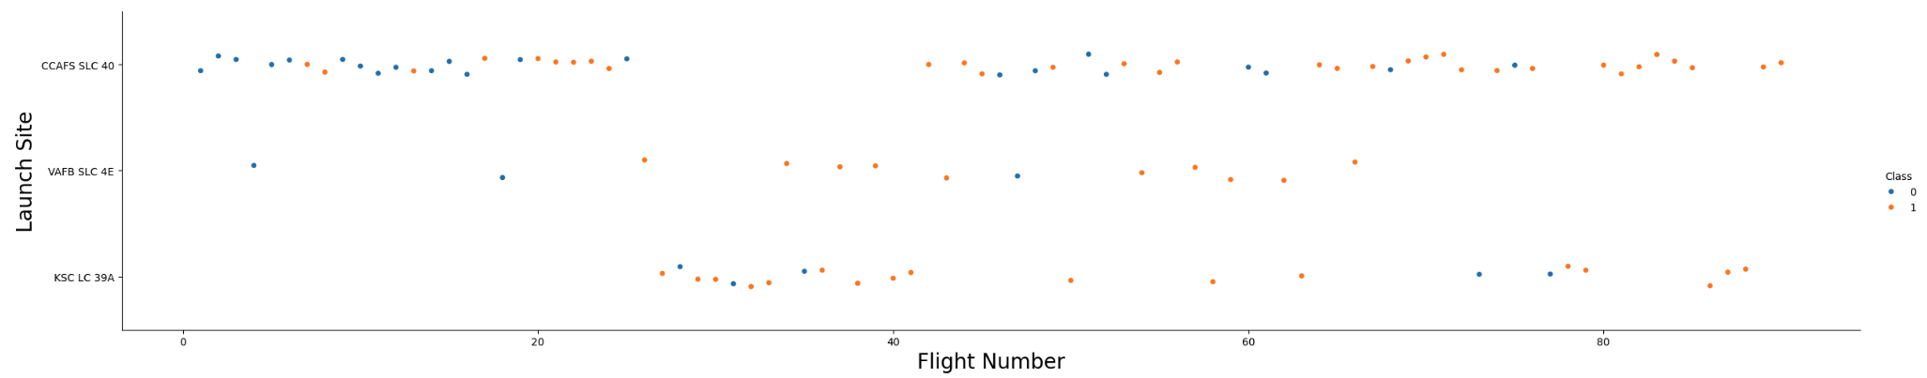
Flight Number vs. Launch Site
Flight Numbers indirectly correspond with time.
Over time, success has improved, given that since Flight 60, only 5 failures are apparent.
Vandenberg AFB and the Kennedy Space Center appear to reflect greater success than the Cape Canaveral site.

Slide 20
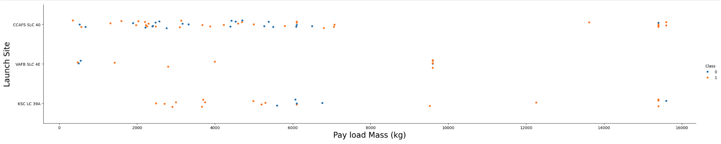
Payload vs. Launch Site
Four payload mass regimes appear to exist:
Very light: 0 – 2500 kg
Light: 2500 – 7500 kg
Medium: 7500 – 14000 kg
Heavy: > 14000 kg
Payload mass appears to influence launch site selection.
Cape Canaveral appears to be selected for all but medium payloads.
Vandenberg AFB appears to support payloads up to medium.
The Kennedy Space Center appears to support all but very light payloads.

Slide 21
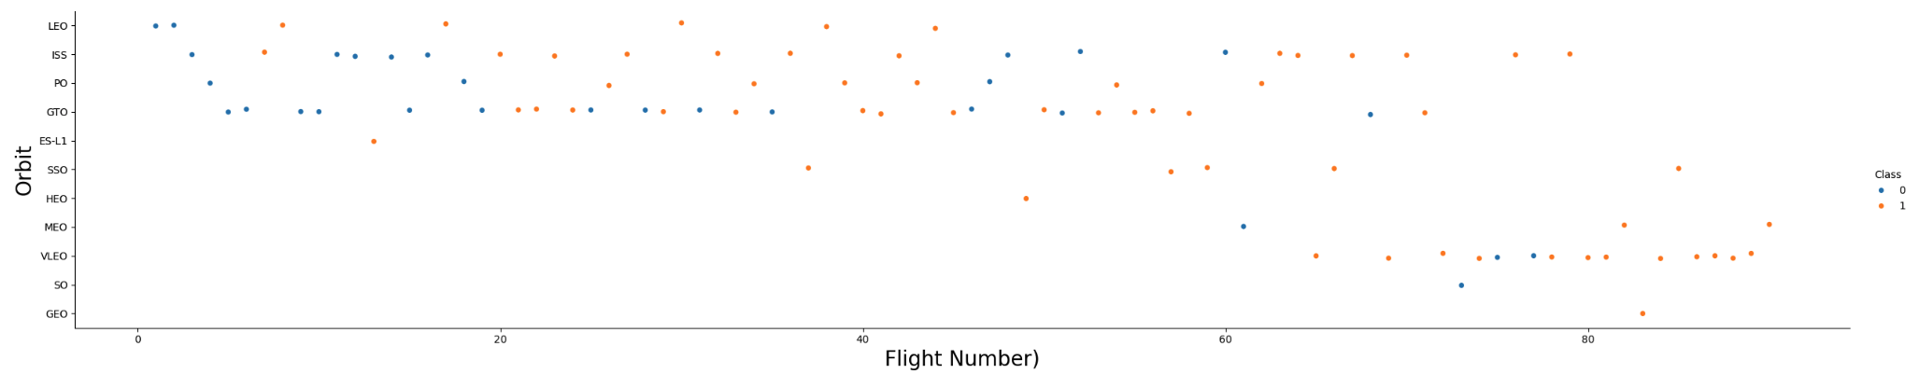
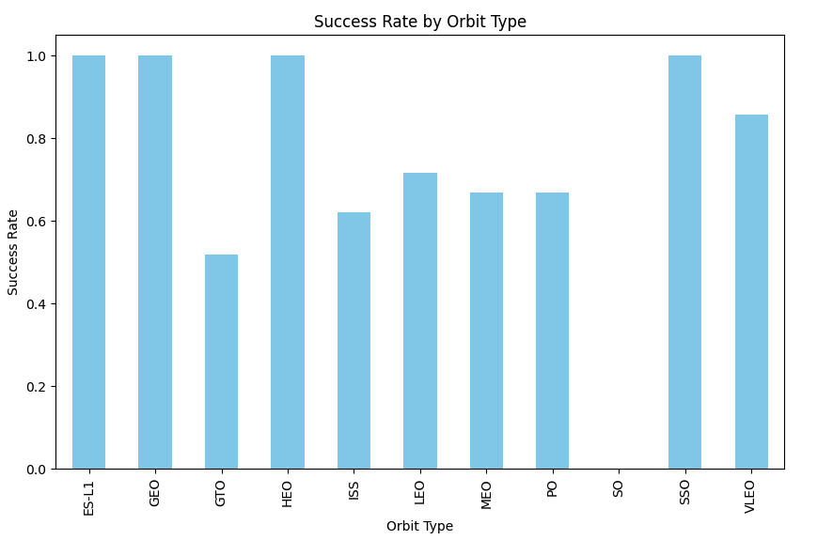
Success Rate and Flight Number vs. Orbit Type
ES-L1, geosynchronous, and high earth orbits are one-offs, with the geosynchronous and high earth orbits at a mature phase of the program. ES-L1 is interesting as it was one of the few successes prior to Flight 20.
Sun Synchronous Orbits have been very successful, but there are only 5, all at a fairly mature stage (Flights 40 – 80 or so).
Very Low Earth Orbits have enjoyed an 80% success rate, also reflecting the mature phase of the program at their inception.
Geosynchronous Transfer Orbits appear to be the worst performers, with about a 50% success rate, but they have been attempted since around the outset, the first being Flight 5. Since Flight 40, they have been around 75% successful.

Slide 22
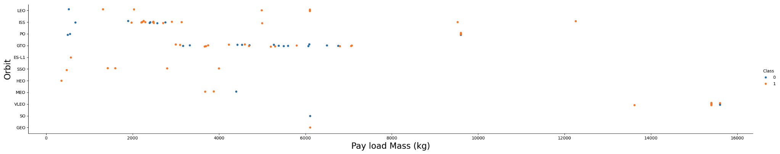
Payload vs. Orbit Type
The heaviest payloads are associated with Very Low Earth Orbits and appear to be about 80% successful.
A medium range of payloads are International Space Station and Polar Orbits and appear to enjoy a 75% or 80% success rate within this range.
Polar Orbits met with no success at 750 kg payloads.
ISS Orbits had a checkered history among missions with payloads less than 4000 kg.
Geosynchronous Transfer Orbits appear to be the most problematic and range between 3000 kg and 7500 kg payloads.

Slide 23
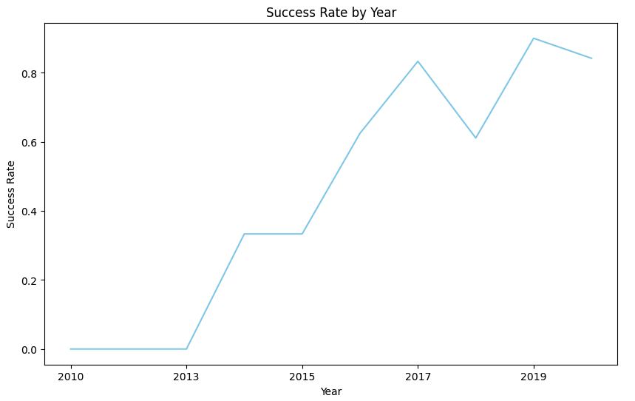
Launch Success Yearly Trend
2010 -2013 reflected a challenging period for SpaceX.
It appears, however, that lessons were learned.
2013 -2017 have each reflected a 20% improvement.
While 2018 represented a local dip, the overall trend remains strongly positive.

Slide 24
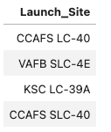

All Launch Site Names
There are two launch sites at Cape Canaveral
There is also a nearby launch site at the Kennedy Space Center
Finally, there is the launch site at Vandenberg AFB.
This is an example of using the DISTINCT qualification to a SELECT statement:

Slide 25
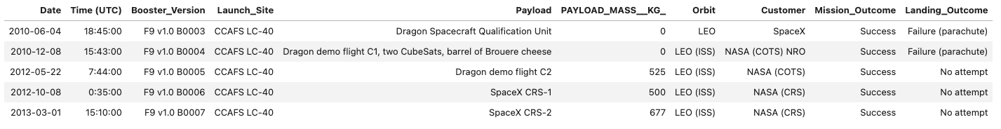
Launch Site Names Begin with 'CCA'
This table reflects the first five records in the data representing launches from Cape Canaveral.
All dates are in the 2010-2013 range during which success rates for landings were 0%.
Payloads for the first two flights were negligible and the next three were in the 500-750 kg range.
All Orbits were Low Earth Orbits, four of which were International Space Station Orbits.
All missions were successful.

Slide 26
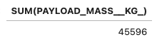

Total Payload Mass
SpaceX has carried 107,010 kg of payload for NASA
As noted on the previous slide, from Cape Canaveral, these missions have been ongoing since May of 2012.

Slide 27
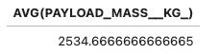

Average Payload Mass by F9 v1.1
Mean payload mass is approximately 2,535 kg.
As noted from previous slides, the payload mass range runs from 0 to nearly 16,000 kg.
Most payload masses appear to run between 2000 – 7500 kg.

Slide 28
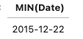

First Successful Ground Landing Date

Slide 29
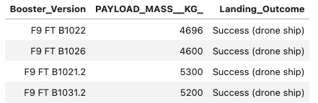

Successful Drone Ship Landing with Payload between 4000 and 6000
Four boosters have passed these criteria.
All four all Falcon 9 FT
Payload mass was near 5000 kg for all four

Slide 30
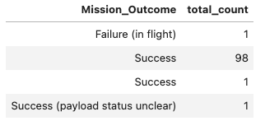

Total Number of Successful and Failure Mission Outcomes

Slide 31
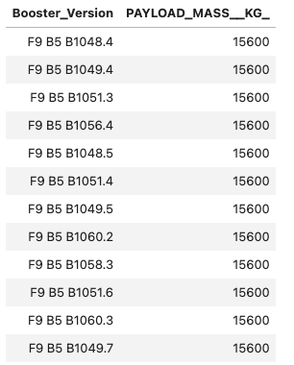

Boosters Carried Maximum Payload

Slide 32
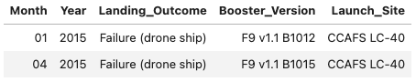

2015 Launch Records

Slide 33
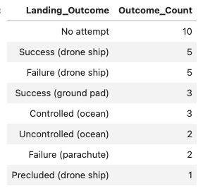

Rank Landing Outcomes Between 2010-06-04 and 2017-03-20
Drone ship recoveries reflect about an even probability of success.
Ground pad recoveries are 100%, but there have been only 3.

Slide 34

Section 3

Slide 35
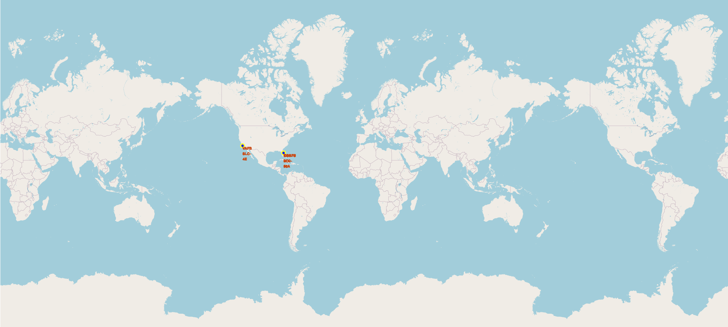
Launch Site Locations
Launch sites are within +/- 5 degrees of 30 degrees North latitude
Launch sites are proximal to coastal areas

Slide 36
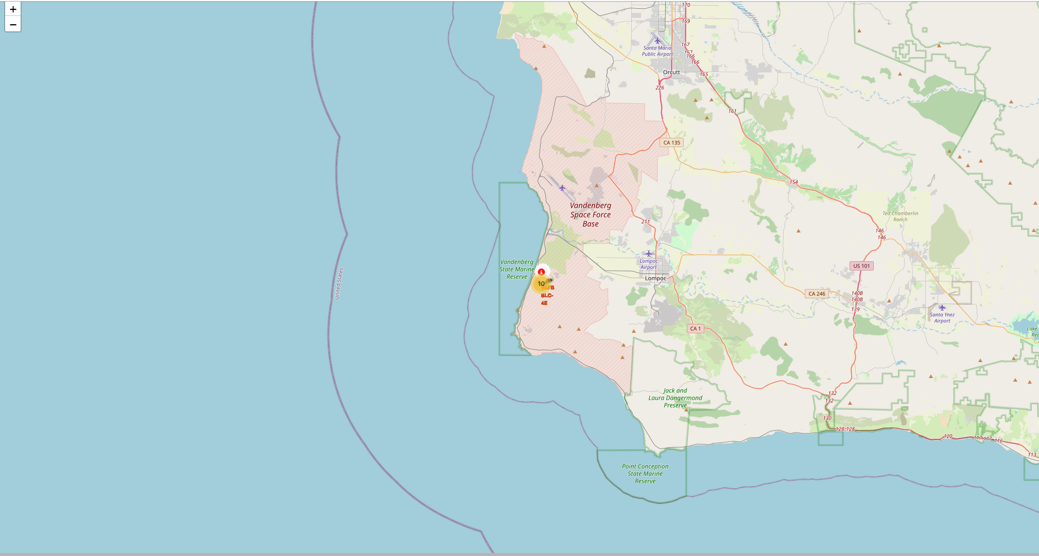
Clustered Result Launch Sites and Launch Results
This is the Vandenberg AFB launch site
The cluster indicates that 10 launches have occurred here
Red and green icons reveal the failures and successes, respectively.

Slide 37
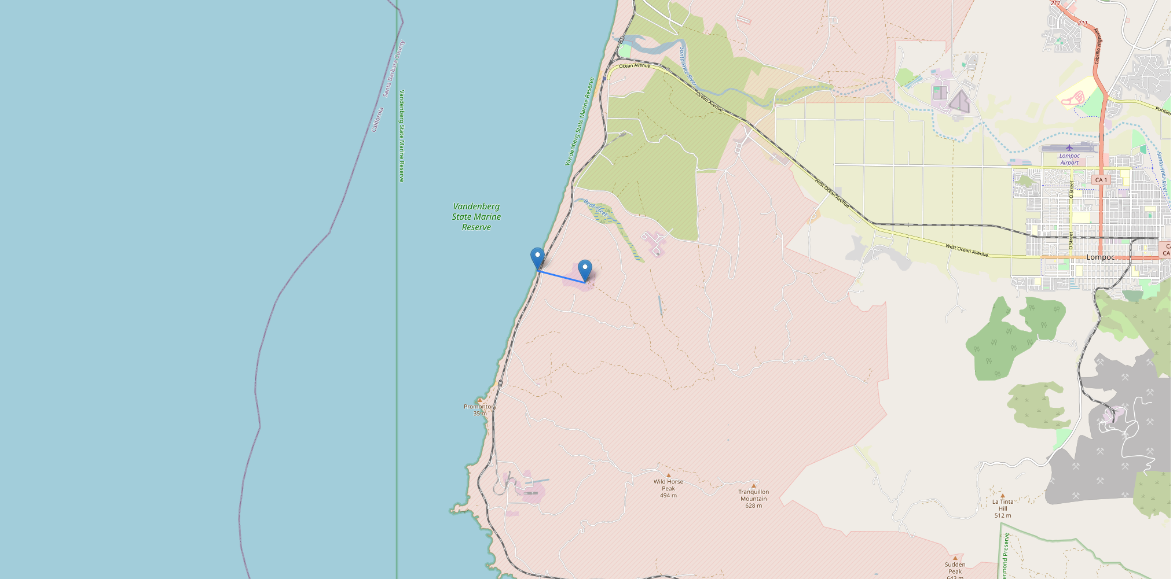
Launch Site Proximity to Coastline
The distance from the launch site to the coastline is 1.35 km or 0.84 miles

Slide 38

Section 4

Slide 39
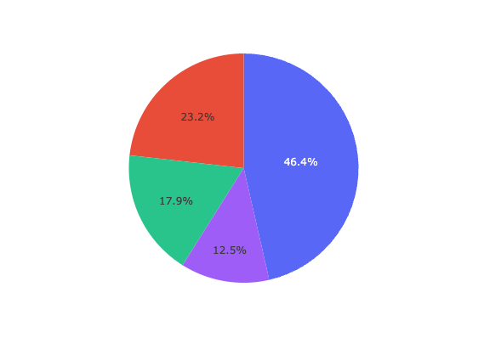
Successful Launches for All Launch Sites
Cape Canaveral LC-40 accounts for 46.4% of all successful launches
The Kennedy Space Center is next greatest contributor of successful launches at 23.2%
Vandenberg AFB is third at 17.9%
Cape Canaveral SLC-40 contributes the least at 12.5%

Slide 40
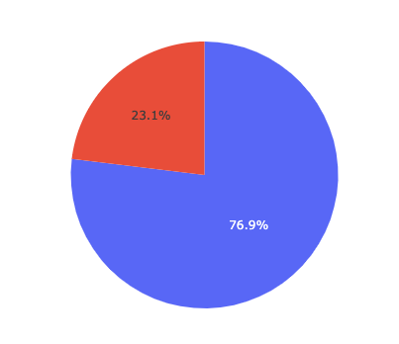
Successful vs. Failed Launches at KSC LC-39A
The Kennedy Space Center has the highest launch success ratio
76.9% of all launches were successful.

Slide 41
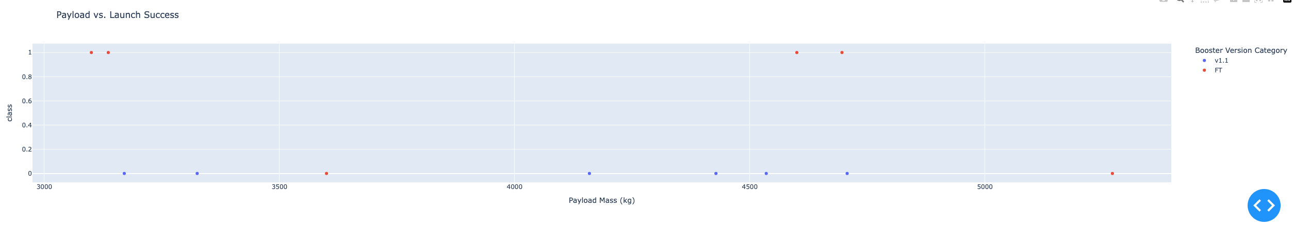
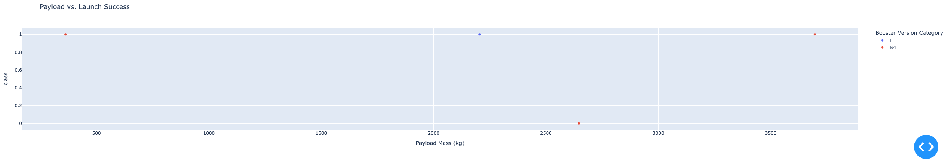
Payload vs. Launch Outcome at Cape Canaveral Sites
This scatterplot reflects outcomes at CCAFS LC-40 for payloads ranging from 3000 – 6000 kg
The Falcon 9 FT has been 83% successful and the v. 1.1 booster has seen no success in this range at this launch site
This scatterplot reflects outcomes at CCAFS SLC-40 for payloads ranging from 0 – 4000 kg
The Falcon 9 B4 and FT boosters have been 75% successful at this site within this payload range.

Slide 42

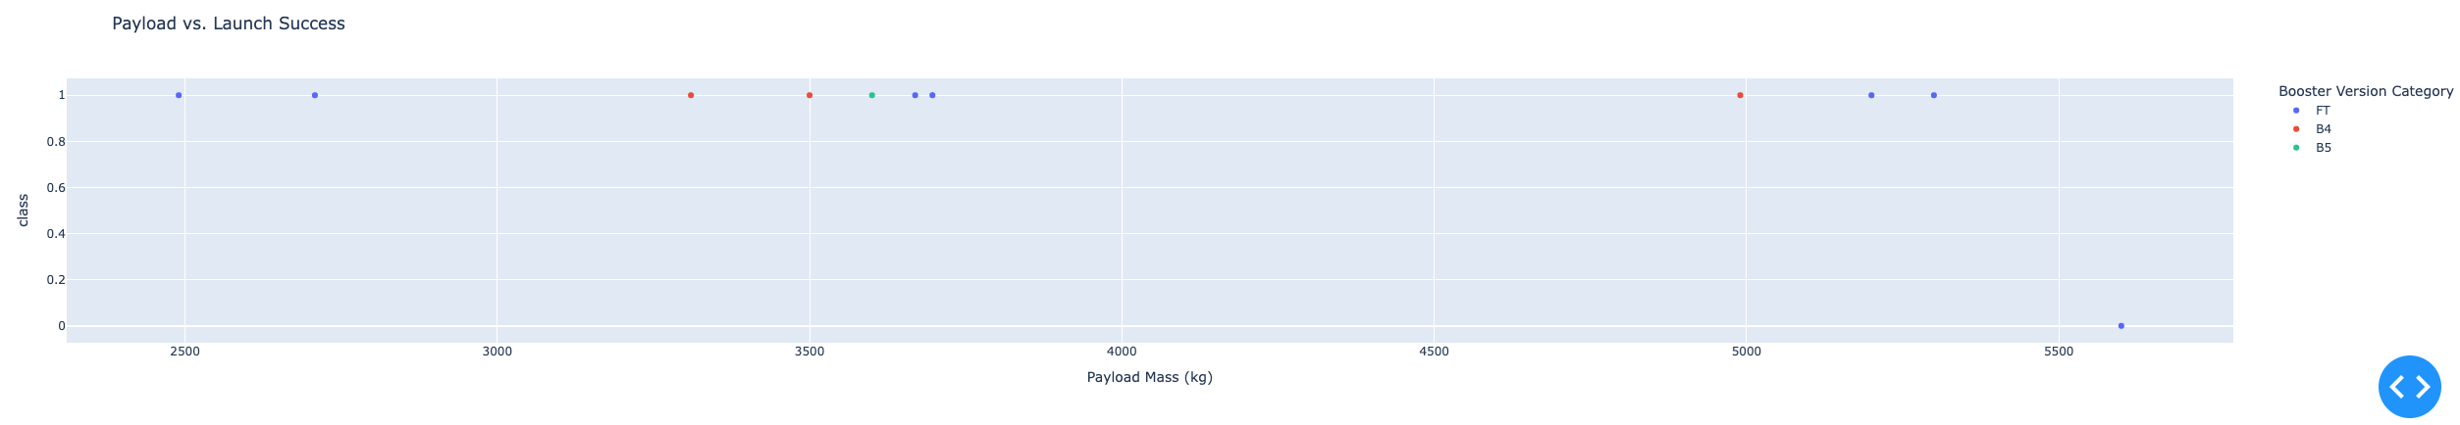
Payload vs. Launch Outcome at VAFB and KSC
This scatterplot reflects outcomes at VAFB SLC4-E for payloads ranging from 0 – 10000 kg
The Falcon 9 FT has been 50% successful, the B4 has been 33% successful, and the v. 1.1 booster and the v. 1.1 booster has seen no success in this payload range at this launch site
This scatterplot reflects outcomes at KSC LC-39A for payloads ranging from 2000 – 6000 kg
The Falcon 9 B4 and B5 boosters have been 100% successful and the FT booster has been 85% successful at this site and within this payload range.

Slide 43

Section 5

Slide 44
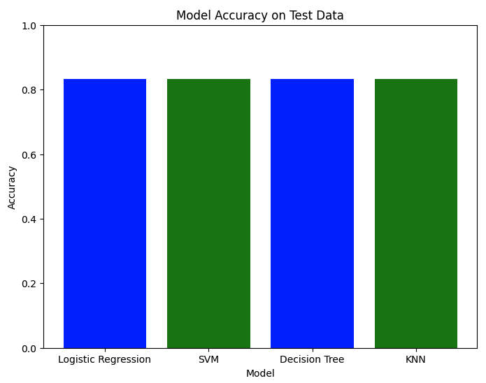
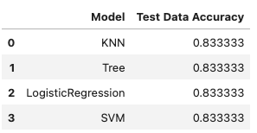
Classification Accuracy
Test data accuracies are uniformly 0.83
The models are equally accurate.

Slide 45
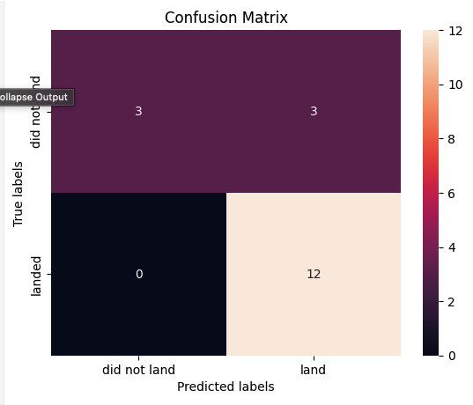
Confusion Matrix
The confusion matrix is identical for all models.
Sensitivy = 0.5
False Positive Rate = 0
Positive Predictive Value = 1.0
False Omission Rate = 0.2

Slide 46
Conclusions
Test data accuracy for all four models is 0.83.
Models employed:
Logistic Regression
Support Vector Machine
Decision Tree
K-Nearest Neighbors
The confusion matrices are likewise identical among the models
Within the test data, 15 out of the 18 observations successfully landed
Recommend going forward with re-useable booster development

Slide 47
Appendix
Include any relevant assets like Python code snippets, SQL queries, charts, Notebook outputs, or data sets that you may have created during this project

Slide 48


